Slide 1


ENHANCING KABADDI WITH SMART SENSOR TECHNOLOGY

Slide 2
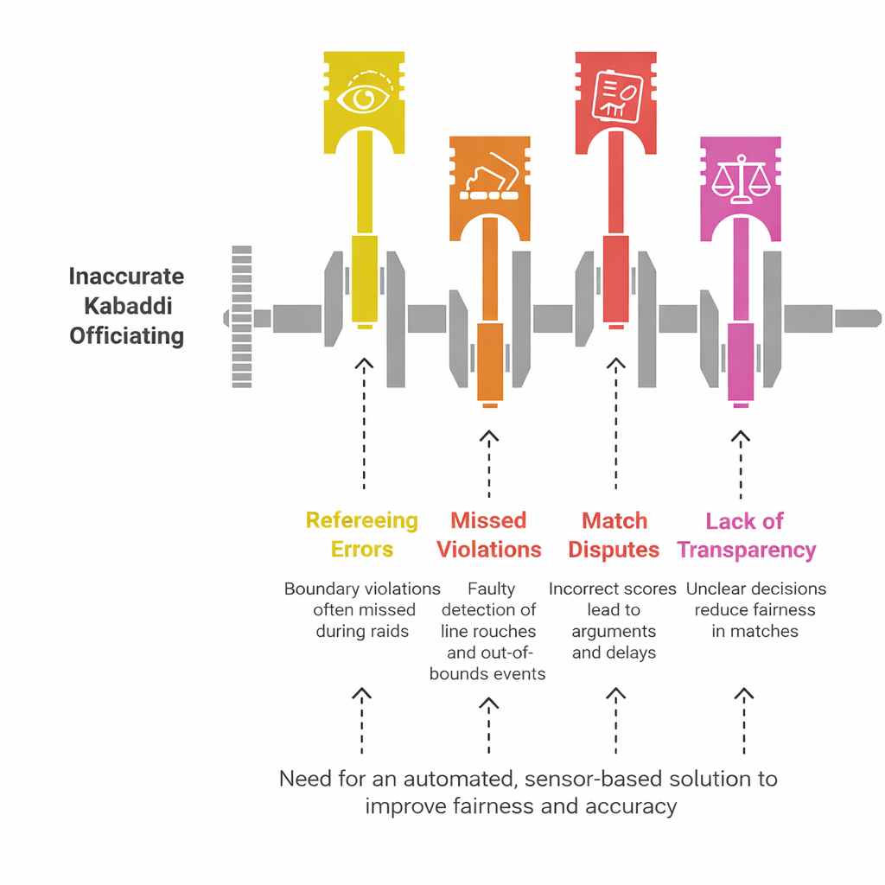



PROBLEM STATEMENT
Frequent human errors in boundary and lobby line decisions occur due to the fast pace and close physical interactions in Kabaddi matches.
Manual refereeing makes it difficult to accurately detect line touches, out-of-bounds movements, and simultaneous player actions during raids.
Incorrect decisions can lead to match disputes, unfair scoring, and loss of transparency in competitions.
There is a strong need for a low-cost, sensor-based smart monitoring system that can automatically detect boundary violations and assist referees with accurate real-time decisions.

Slide 3
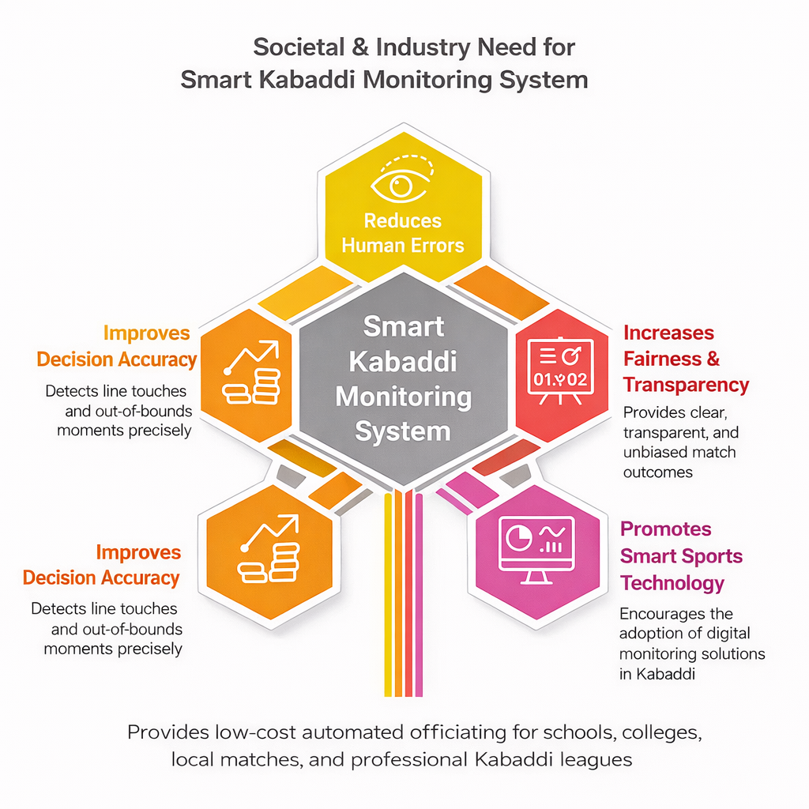

SOCIAL /INDUSTRY NEEDS
Reduces dependence on only manual refereeing and minimizes human errors during fast Kabaddi matches.
Improves decision accuracy in detecting boundary touches, lobby entries, and out-of-bounds situations.
Provides a low-cost technological solution for schools, colleges, local tournaments, and professional Kabaddi leagues.
Enhances fairness, transparency, and credibility in Kabaddi competitions.
Promotes the adoption of smart sports technology and digital monitoring systems in traditional sports.

Slide 4
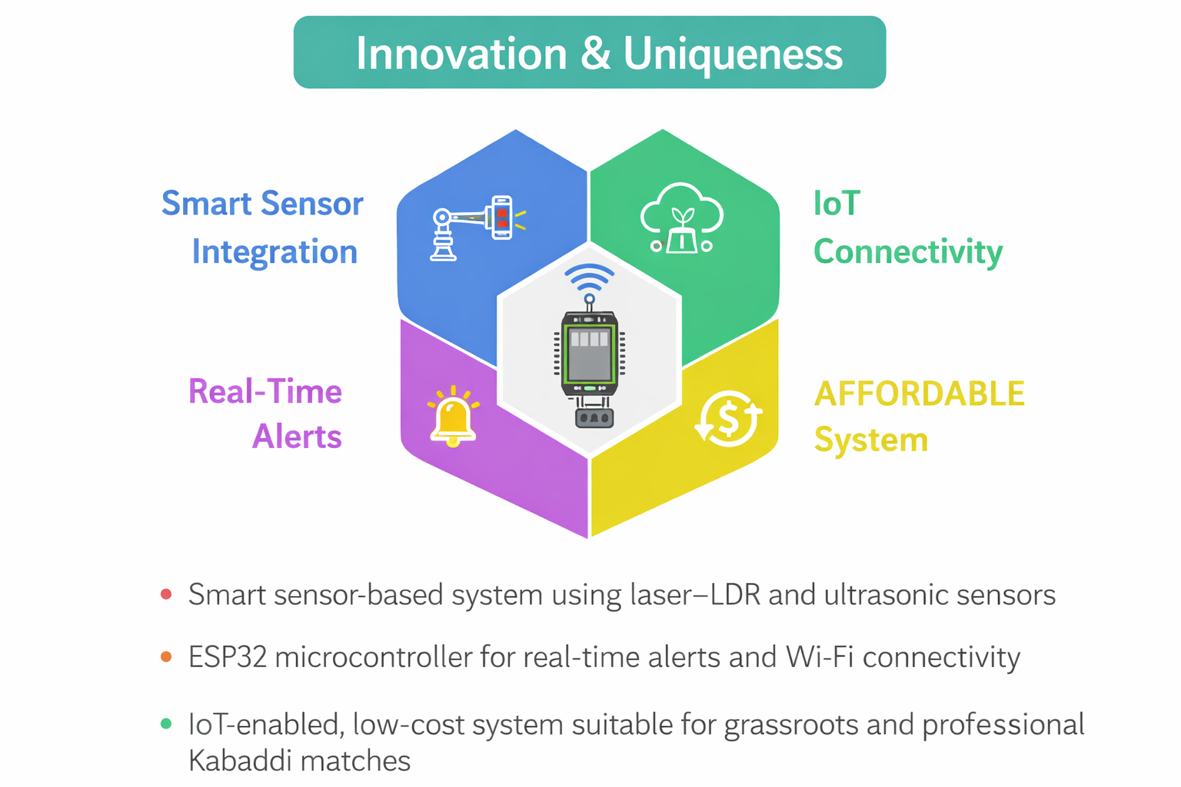




INNOVATION AND UNIQUENESS
The project introduces a smart sensor-based Kabaddi monitoring system that detects boundary touches and out-of-bounds movements using laser–LDR sensors and ultrasonic sensing techniques.
Unlike traditional refereeing methods, the system automatically detects line violations and player movements in real time, reducing human errors and improving decision accuracy.
It integrates boundary detection, player position monitoring, decision processing, and real-time display modules into a single compact embedded system using an ESP32 microcontroller.
The system promotes fair play and transparency in Kabaddi matches by providing reliable technological support for referees and enabling real-time monitoring through IoT connectivity.

Slide 5
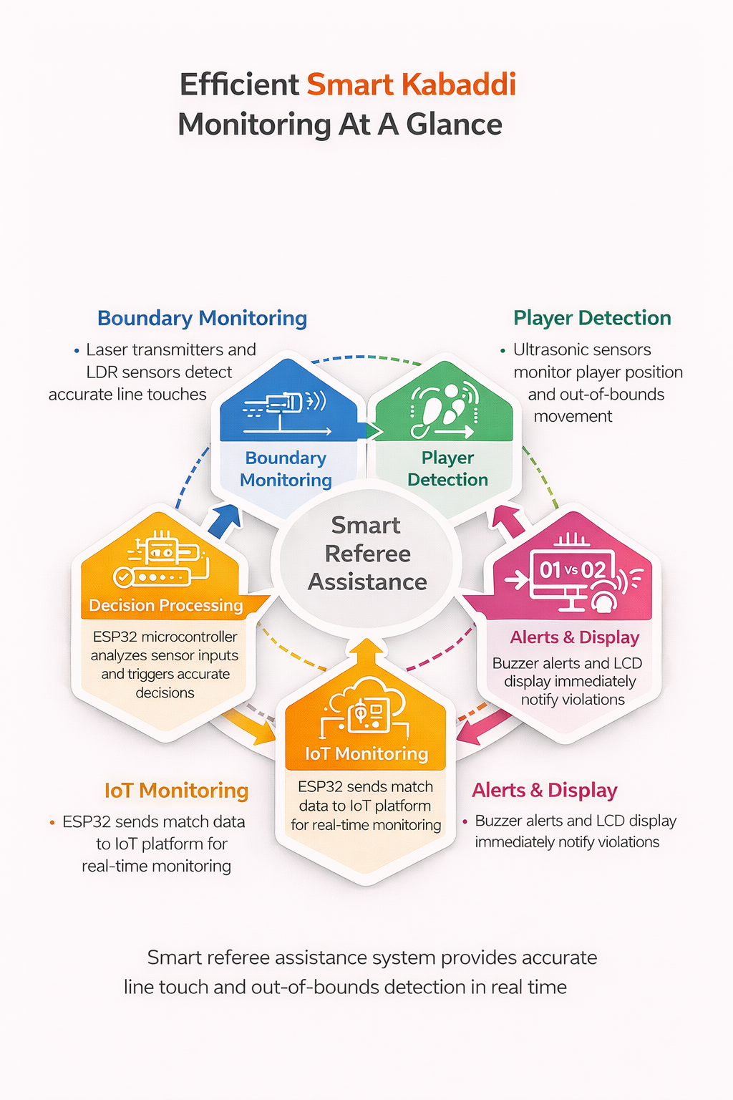
NOVELTY OF THE IDEA
Integrates laser–LDR boundary detection, ultrasonic player monitoring, and ESP32-based decision processing into a single smart system for Kabaddi match monitoring.
Enables real-time detection of line touches, lobby entry, and out-of-bounds movements during fast gameplay using sensor-based technology.
Provides instant alerts through LCD display, buzzer notifications, and IoT connectivity to assist referees in making accurate decisions.
Specifically designed for Kabaddi courts with simple installation and low-cost components, making it practical, scalable, and innovative for schools, tournaments, and professional matches.

Slide 6
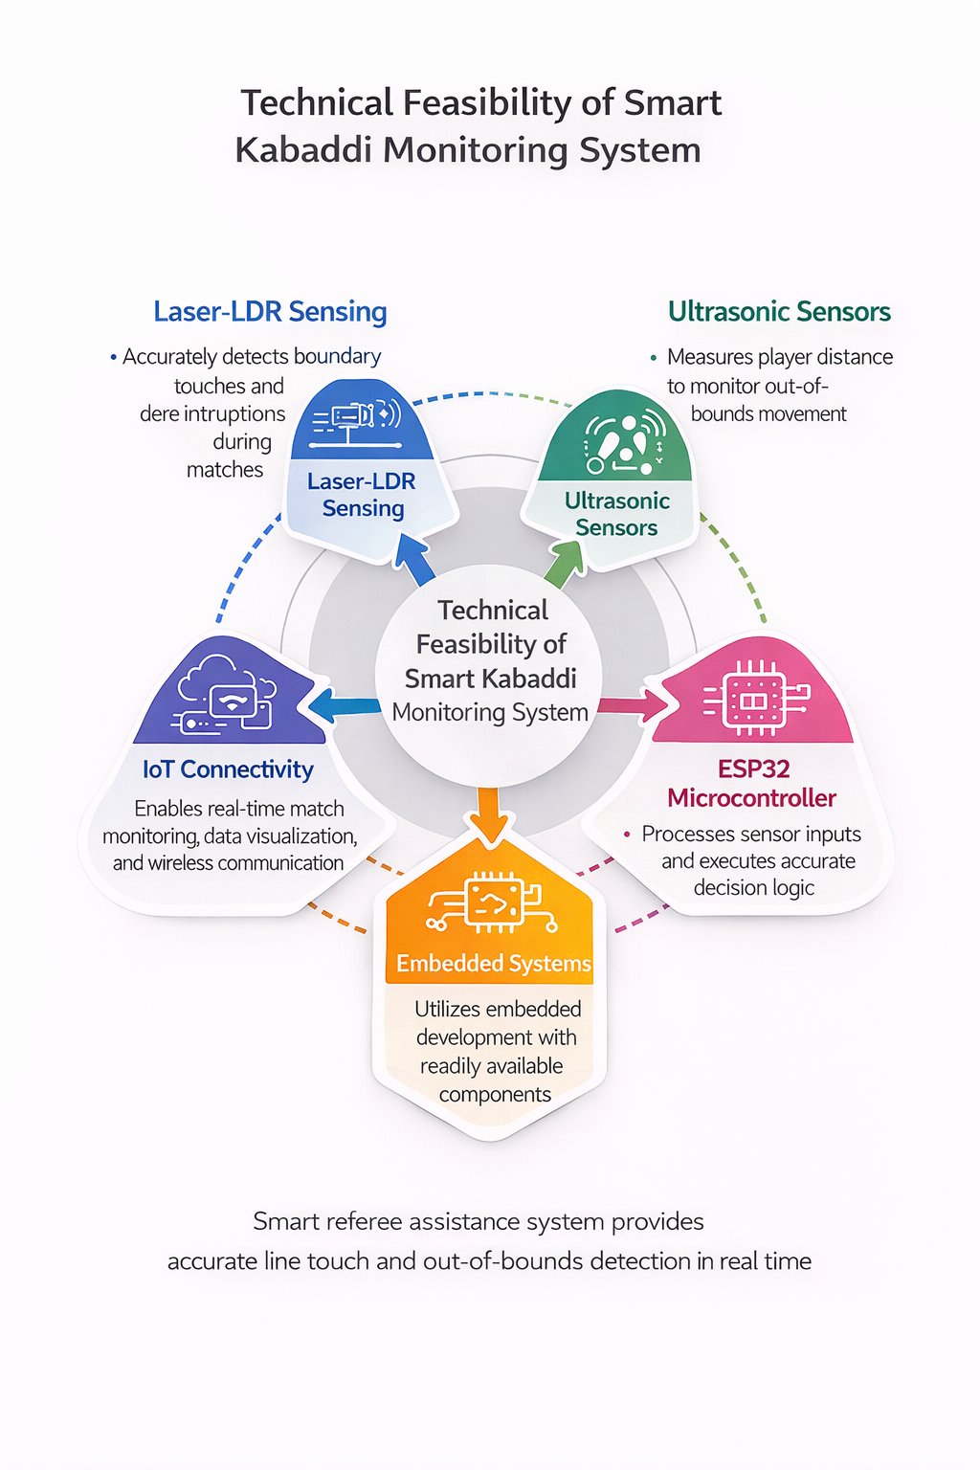
TECHNICAL FEASIBILITY
Laser transmitters and LDR sensors can accurately detect boundary touches and line interruptions in real time during Kabaddi matches.
The ESP32 microcontroller efficiently processes sensor inputs, executes decision logic, and controls alerts using readily available electronic components.
Integration with IoT platforms and LCD display modules enables real-time match monitoring, data visualization, and wireless communication using existing hardware and software tools.

Slide 7
BUSINESS MODEL AND MARKET
Follows a hybrid deployment model with direct sales of smart Kabaddi monitoring kits to sports academies, schools, colleges, and tournament organizers at an affordable cost.
Offers installation and rental services for tournaments and leagues, allowing organizers to use the system during events without high initial investment.
Enables sports technology startups or service providers to offer smart referee assistance systems on a contract basis for Kabaddi competitions.
Targets Kabaddi leagues, sports federations, training academies, and local tournament organizers, with growing demand for accurate and technology-assisted officiating.
Supports scalability through smart sports infrastructure adoption, increasing popularity of Kabaddi, and integration with digital sports analytics platforms.

Slide 8
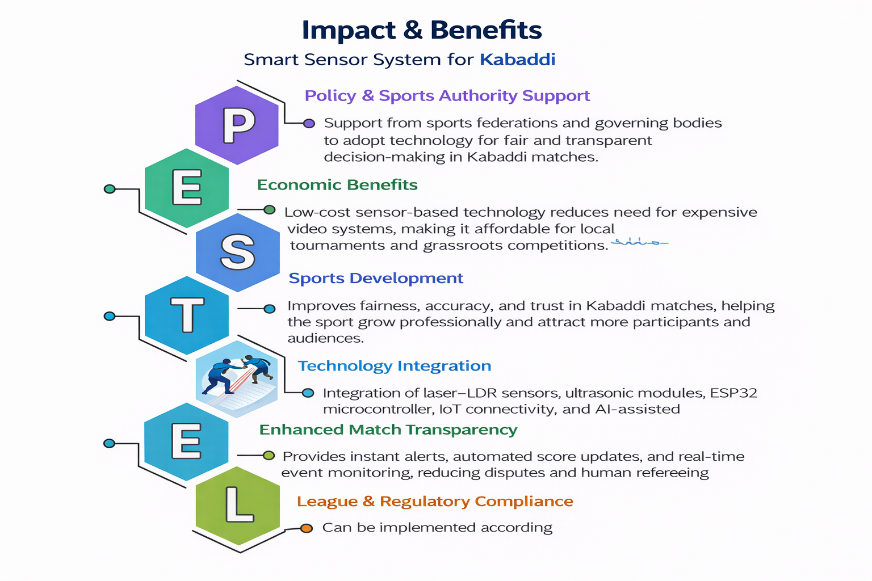
COMMERCIAL POTENTIAL
Large number of Kabaddi tournaments, sports academies, schools, and colleges creates strong demand for smart monitoring systems.
Low-cost sensor-based design makes the system affordable and accessible for local tournaments and training centers.
Generates revenue through direct sales of smart referee kits, installation services, and rental models for tournaments and leagues.
Growing popularity of Kabaddi and expansion of professional leagues like Pro Kabaddi League increases opportunities for sports technology solutions.
Increasing adoption of digital sports analytics and smart stadium technologies enhances scalability and commercial potential of the system.

Slide 9
MARKET / COMMERCIAL POTENTIAL
Category | Component | Industrial Specification | Qty | Purpose | Approx Cost (₹)
Controller System | ESP32 Development Board | WiFi + Bluetooth MCU | 1 | Main control unit for sensor processing and IoT communication | 700
Boundary Detection | Laser Diode Modules | 650nm 5V Laser Transmitter | 5 | Creates laser beams along court lines for boundary detection | 500
Boundary Detection | LDR Sensor Modules | Light Dependent Resistor Sensor | 5 | Detects laser beam interruption when player crosses line | 600
Player Monitoring | Ultrasonic Sensors (HC-SR04) | Distance Range 2cm–400cm | 2 | Detects player position near lobby and boundary area | 300

Slide 10
MARKET / COMMERCIAL POTENTIAL
Category | Component | Industrial Specification | Qty | Purpose | Approx Cost (₹)
Display System | LCD Display | 16×2 LCD with I2C Module | 1 | Displays match alerts and system status | 350
Alert System | Buzzer Module | 5V Active Buzzer | 1 | Gives sound alert when violation detected | 100
Communication | IoT Connectivity | ESP32 WiFi Integration | 1 | Sends match data to IoT platform for monitoring | 0
Power Supply | Rechargeable Battery | 12V 7Ah Battery | 1 | Provides portable power supply | 1200

Slide 11
MARKET / COMMERCIAL POTENTIAL
Category | Component | Industrial Specification | Qty | Purpose | Approx Cost (₹)
Voltage Regulation | Buck Converter | 12V to 5V DC Converter | 1 | Regulates voltage for sensors and ESP32 | 200
Structural Setup | Kabaddi Court Sensor Frame | PVC / Aluminum Mount | 1 | Holds sensors along court boundaries | 4000
Wiring & PCB | PCB Board + Connectors | General Purpose PCB | 1 | Circuit integration and connections | 800
Assembly Materials | Cables, Mounts, Enclosure | Industrial grade wiring kit | 1 | Installation and protection of components | 1200

Slide 12
FUTURE SCOPE
It can be enhanced with advanced AI and computer vision models to automatically track player movements and detect complex match events.
Integration with IoT and cloud platforms can enable real-time match analytics, remote monitoring, and digital score management.
The system can be upgraded with high-speed cameras and machine learning algorithms for more accurate boundary and player tracking.
Can be integrated with smart stadium infrastructure and digital referee systems for professional sports leagues.
Adaptable for other sports such as Kho-Kho, badminton line detection, and training performance analysis.
Provides scope for large-scale deployment in sports academies, leagues, and smart sports technology startups.

Slide 13
TEAM CAPABILITY
Capable of developing both hardware components (laser-LDR boundary detection, ultrasonic monitoring system, microcontroller control unit) and software logic for real-time decision processing.
Experience in integrating sensors, ESP32 microcontrollers, IoT communication modules, displays, and alert systems for automated sports monitoring applications.
Ability to design low-cost, accurate, and real-time referee assistance systems suitable for Kabaddi courts, sports academies, and smart stadium environments.

Slide 14
TEAM SCABILITY
Suitable for large-scale deployment in sports academies, schools, and professional Kabaddi leagues due to the use of low-cost sensors and simple electronic components.
Can be expanded through sports technology services, referee assistance systems, and smart stadium infrastructure integration.
Adaptable to other sports such as Kho-Kho, badminton line detection, and training analytics systems, increasing usability and market potential.

Slide 15
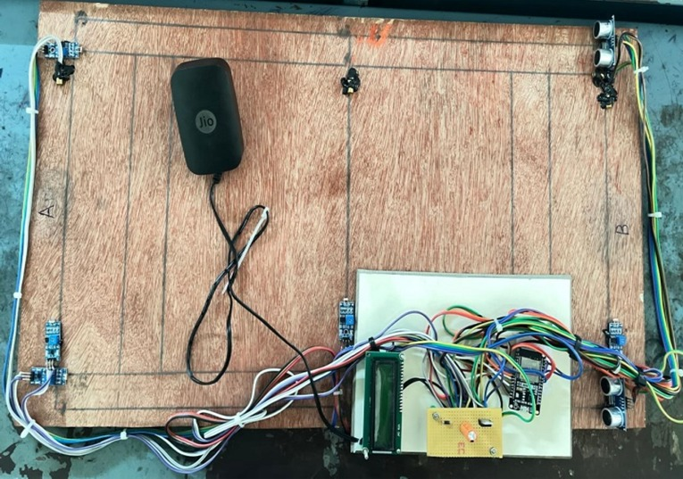
HARDWARE IMAGE

Slide 16
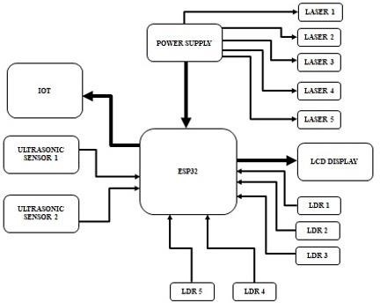
BLOCK DIAGRAM

Slide 17
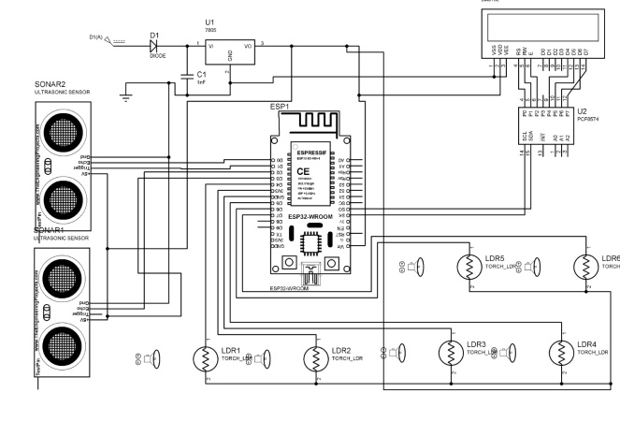
CIRCUIT DIAGRAM

Slide 18
MODES OF OPERATION
Detection Mode: Laser transmitters and LDR sensors detect line interruptions when a player touches or crosses the boundary during the Kabaddi match.
Player Monitoring Mode: Ultrasonic sensors continuously track player position near the lobby and boundary areas to determine whether the player is inside or outside the court.
Decision Processing Mode: The ESP32 microcontroller processes signals from sensors and applies programmed logic to determine valid boundary touches or out-of-bounds conditions.
Alert & Display Mode: When a violation is detected, the system activates a buzzer and displays the decision instantly on the LCD screen for referee assistance.
IoT Monitoring Mode: Match events and sensor data are transmitted through Wi-Fi to an IoT platform for real-time monitoring, data logging.

Slide 19
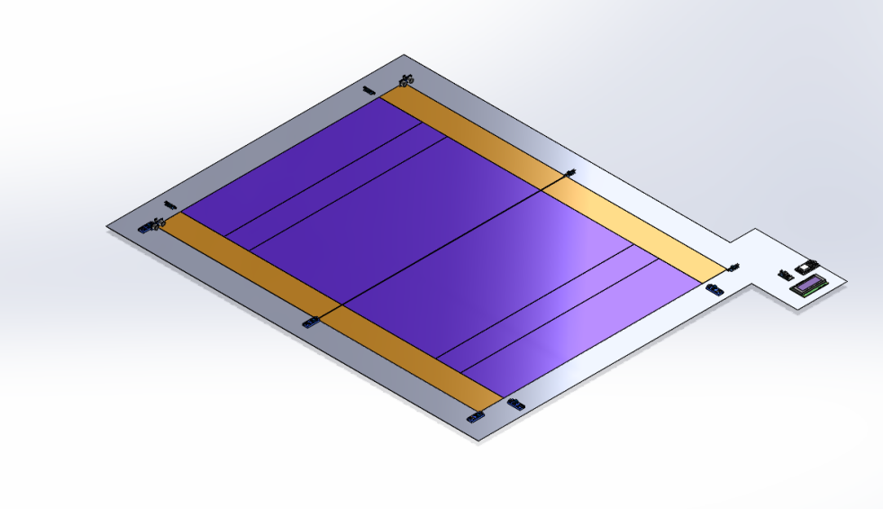
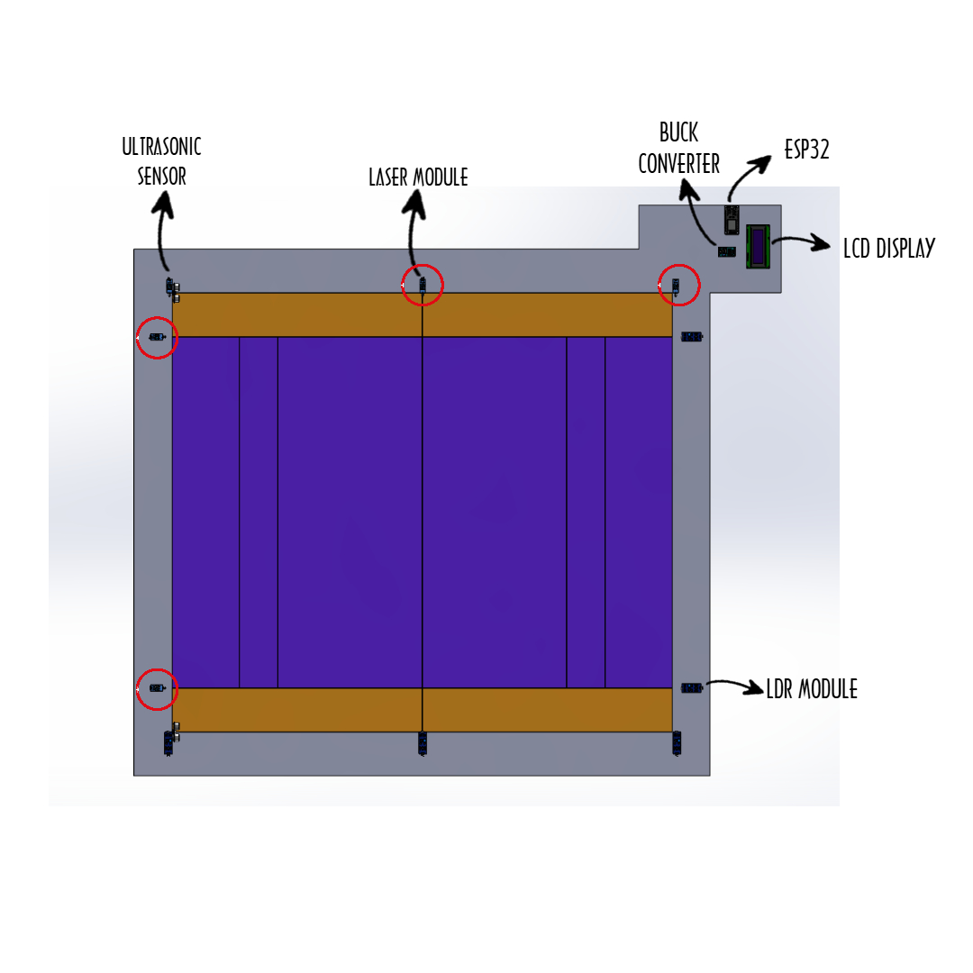
3D DESIGN

